Slide 1
Managing Parties and Security Note: Security is a complex topic, and some feel that it should be left to the Engagement Manager to deal with. We will not cover this topic in great detail, but will examine all of the concepts and some Best Practices.
October, 2013

Slide 2
Agenda
Users & User Groups
Permissions & Permission Groups
Organizations
Putting it all together
Notes:
2

Slide 3
Managing Parties - Standard Concepts
What is a Party (also referred to as an Organization) ?
An External Party is an organization such as a supplier or vendor
An Internal Party is an internal organization that is responsible for creating a contract or managing it through the negotiation process
External Party
Non-hierarchical
Primary Contact is not mandatory
Internal Party
Can be hierarchical
Primary Contact is mandatory
Plays a role in setting up security permissions
An internal party can be a legal entity or a non-legal entity. If the name and address of the internal party is to appear on the contract, then the internal party must be set as a Legal Entity.

Slide 4
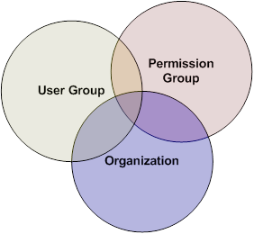
Security Model: Standard Concepts
Security in ECM is driven by three main factors:
User Group(s) that the user belongs to
Groups of users who will have similar or the same functional needs
Permission
Specifies a feature or object and the activity allowed against it (Contract Read, Term View, ...)
Can be either class-level (inherited by class instances) or instance-level
A set of permissions (a Permission Group) is assigned to a one or more user groups
Organization that the user belongs to
Visibility of contracts can be set on an organizational basis (when user group members span organizations)
Intersection defines what the final user capability is:
4th factor: Task management on a contract. I.e.,
when a task is assigned to a user, the permission to
perform the task is automatically assigned (even if
the user wouldn’t normally be able to perform the task)

Slide 5
Security Model-User Group
User Groups
User Groups are created to group individuals into similar roles; e.g.,
Purchasing
Legal
Security
User groups are also used to define approval groups; e.g.,
Head of Department
Tax
Audit
Organizations work across user groups, so two users can be in the same group, but in different organizations, and will not necessarily be able to see each other’s contracts.
Users can belong to many User Groups if required

Slide 6
Users & User Groups
Internal and external users, and User Groups, are added to the system through Virtual Supply Master → Administration
What VSM calls “Groups”, ECM calls “User Groups”
VSM is also where Users are added to Groups
Creation and update of Users and Groups is reflected in ECM almost instantaneously
In VSM, Groups can be Internal or External, but only Internal groups are used in ECM
There are ~14 predefined User Groups shipped with ECM (and stored in VSM).
See the Security Administration Guide for the list of them, plus which permission group(s) (to be discussed) each one is linked to.

Slide 7
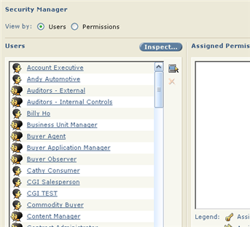
Users & User Groups, cont.
Users and User Groups appear by default on the left side of all Security Lists.
You get to the following via Administration > Security > Security Manager.
User Groups are also used to associate sets of users to Notifications, Tasks, and Approvals.
User
User Group

Slide 8
Agenda
Users & User Groups
Permissions & Permission Groups
Organizations
Putting it all together
Notes:
8

Slide 9
Permissions
There are ~320 Permissions supplied with ECM
Two types of Permissions:
Class-Level
Instance-Level (contract, contract template, clause, clause template, term definition, folder)
Five Types of Actions (CRUD + P) are controlled by permissions:
Create
Read
Update
Delete
Perform

Slide 10
Permission names
Permission name is composed of:
Feature Name (Plural indicates class level, singular indicates instance level)
“>” (separator)
Tab or Sub-Feature Name [optional]
“>” (separator) [optional]
Access (CRUD+P)
Examples:
Term Definitions > Create
Contract Template > Properties > Update
User-Defined Properties > Administer > Perform

Slide 11
Permissions
Permissions allow users to:
See the existence of objects that have instance-level security
Access Administration links (through “Perform” permissions)
See sub-tabs for objects
Access objects for creators
Read or update a contract, even if you don’t have a task on the contract
Permissions do not apply to external users. Instead, external users are limited
to certain activities within the authored/received contract or amendment to
which they are party. Internal users acting as the external party of a contract
are also restricted to external user activities within that individual contract.

Slide 12
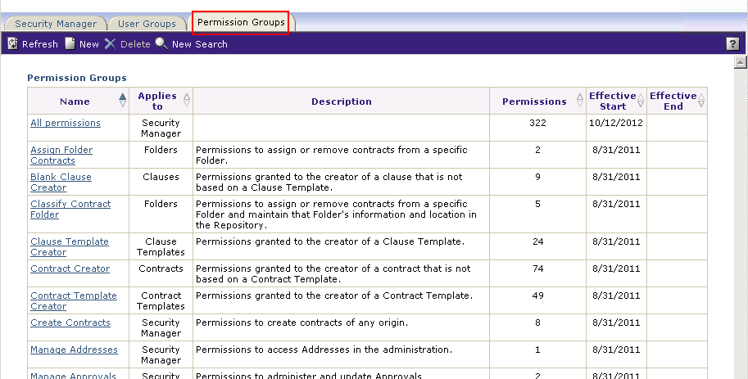
Permission Groups
Permission Groups are sets of permissions that simplify the assignment of related permissions to user groups (or users).
There are ~65 predefined Permission Groups shipped with ECM.
See the Security Administration Guide for the list of them, plus which permissions each one includes.
Each Permission Group has a Type that defines what it applies to (see the “Applies to” column in this screen shot).

Slide 13
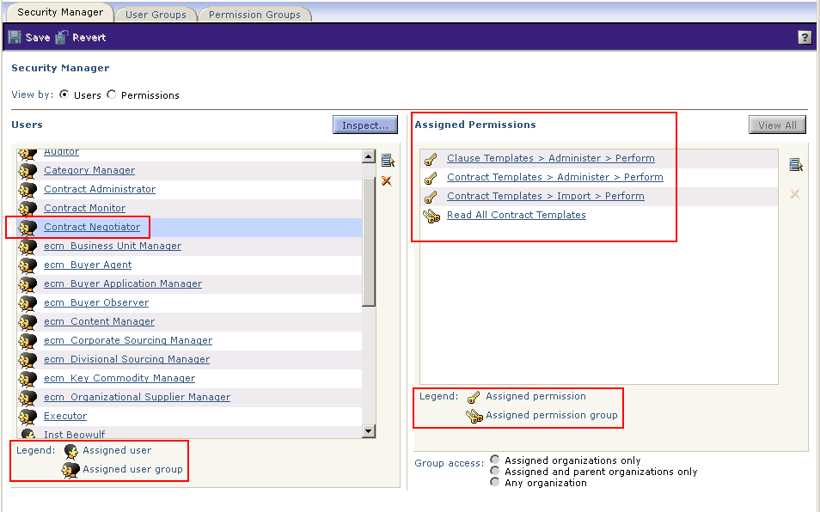
Permission “Grants”
A permission grant occurs when one user or user group is assigned a single permission or a permission group.
Security supports Grant only; cannot revoke a permission from a user or user group
In Security Manager, selecting the user or user group causes its assigned permissions to be displayed under Assigned Permissions.
It is a Best Practice to never assign Class-level permissions to individual users, only to user groups (even if this causes you to have some user groups with only one user).

Slide 14
Security Groups
User Group = Collection of Users
Permission Group = List of Permissions

Slide 15
Agenda
Users & User Groups
Permissions & Permission Groups
Organizations
Putting it all together
Notes:
15

Slide 16
Security Model - Organizations
Organizations
Organizations (Legal Entities / Categories / Countries) can be structured in a logical Hierarchy
Organizations do not have to be Legal Entities, but the contracting party on a contract must be.
Visibility of contracts can be restricted on a organizational basis to other members of the owner’s user group being:
(a) in the same organization, or
(b) in the same or a parent organization, or
(c) in any organization (i.e., not restricted)
(More about this later …)
A User can belong to only one organization, but a User Group can have members from multiple organizations.

Slide 17
Security & Organizations
Organizations impact security for:
Clauses
Clause templates
Contracts
Contract templates
Term definitions

Slide 18
Organizations on Templates
An individual is a member of only one organization at a time in ECM (but as of V10.0.1, can be in a different organization for Sourcing, for example)
Organizations are used to select which members of a user group have access to an object
Organizations are assigned:
To User(s)
To Objects

Slide 19
Agenda
Users & User Groups
Permissions & Permission Groups
Organizations
Putting it all together
Notes:
19

Slide 20
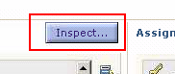
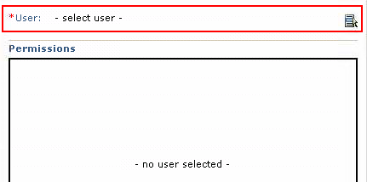
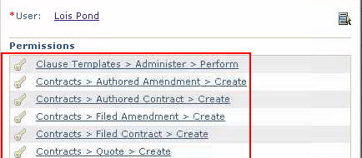
Demonstration / Exercise
For a particular user, what class-level ECM permissions does he/she have?
Log in to SSM as a user with ECM Admin permissions, and go into Contract Management.
Go to the Security Manager: Administration > Security > Security Manager > View by Users
Click the Inspect button. As prompted, select a user; when you click on that user, the Inspect User window is displayed with all of the user’s permissions, either assigned directly or inherited from one of the user’s User Groups or a Permission Group.
You can also do the opposite: View by Permissions > Inspect > select a Permission, and it will display all of the users with that permission.

Slide 21
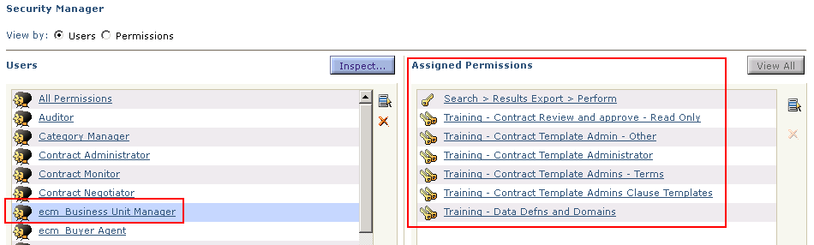
Demonstration / Exercise, cont.
We can answer the question in a different way. This allows us to also find the user’s User Groups and which permissions each group “brings” to the user.
Find what User Groups the user is in. Either:
Look at user’s Profile in VSM, either through an Admin user or the user’s logged in session. Applications tab > Contract Management > Assigned Groups; e.g., you might see “ecm_Business Unit Manager”. OR …
In ECM: Administration > Parties > Individuals > (search for the user and click on the link for him/her) > click on the “View User Account” icon (a head that looks rather like Elvis). The user’s User Groups are listed there.
In ECM (logged in to SSM as a user with ECM Admin permissions): Administration > Security > Security Manager > View by users – see below.
Find each of the user’s assigned groups, click in its line (not the link), and see permissions in the pane on the right. The user may also have permissions assigned directly to him/her (but this is not recommended). The set of all of these permissions tells you what the user is allowed to do.

Slide 22
Key Terms for Security
Contract Management Objects
Instance security access
Class security access
Security Lists
Notes:
22

Slide 23
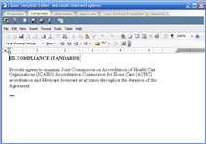
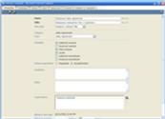
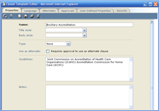
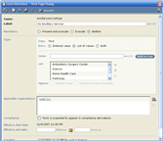
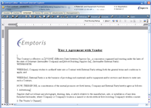
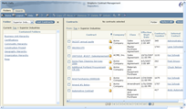
Contract Management Objects
1
4
Clauses
Contract
Templates
2
5
Clause
Term
Templates
Definitions
3
6
Contracts
Contract
Folders

Slide 24
Instance vs. Class Access
Notes:
24

Slide 25
Instance vs. Class Access
Class Access
Granted through Security Manager
Provides access to all instances of the same kind of objects
e.g., Contracts, Contract Folders, Contract Template, Term Definitions, …
Done via Permissions for specific activities/features for the class
e.g., Clause Template > Approvals > Update
This is the normal and preferred method for the bulk of the security setup, because it is the easiest to set up and administer.
Instance Access
Granted through security lists within objects by object creator or administrator.
Provides access on case-by-case basis to one specific object
Instance permissions are also granted automatically by ECM when you create certain objects.
For example, if user ABC creates clause template XYZ, ABC is assigned the Clause Template Creator permission group (which includes many permissions, such as Clause Template > Properties > Update) for instance XYZ. This ensures that ABC will still be able to manage XYZ, even if the class-level permissions ABC has to manage clause templates are removed. (However, without the Clause Templates > Administer > Perform permission, the user would not see a link for Administer > Standards > Clause Templates.)

Slide 26
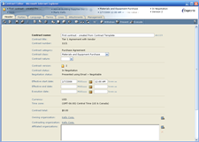
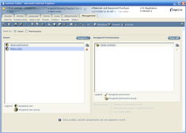
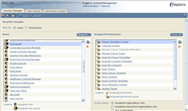
Instance vs. Class Access
Instance Access
(e.g., for Contracts, managed via Contract Editor > Management > Security)
Class Access
(Managed via Administration > Security > Security Manager)
Notes:
26
“Instance” access permits users to see only one object!
“Class” access permits users to see all objects of same type!

Slide 27
Security Lists
At least one Security List applies, either explicitly or by default, to each object class and each instance of most object classes
A Security List consists of:
A list of Users and/or User Groups
A set of Permissions and/or Permission Groups for each User and User Group
Within the context of the Security List, each User Group can have its members' access restricted by their organizations in relation to the organizations of the object.
Notes:
27

Slide 28
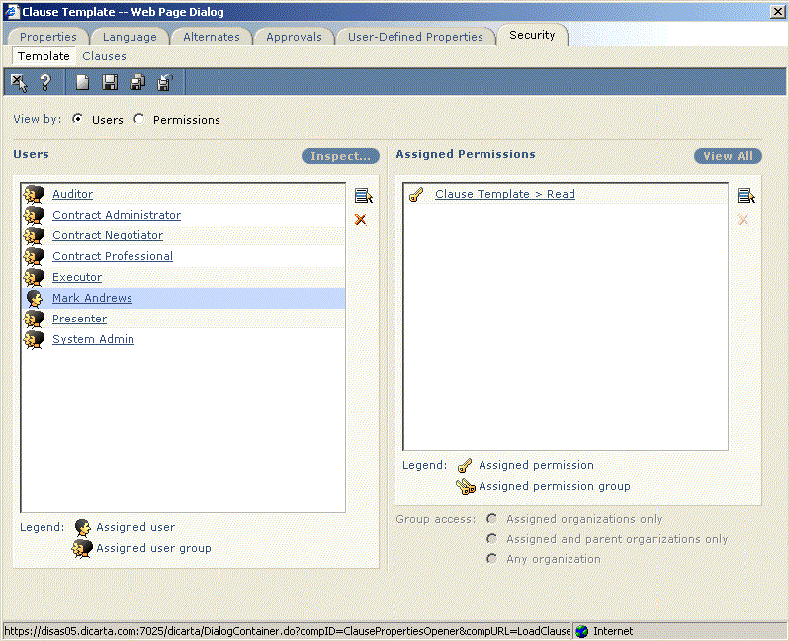
Security Lists, cont.
Security List
Contracts
Objects
or
Security Manager

Slide 29
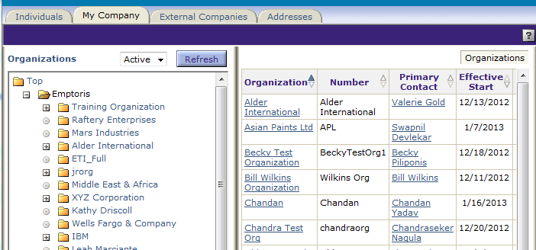
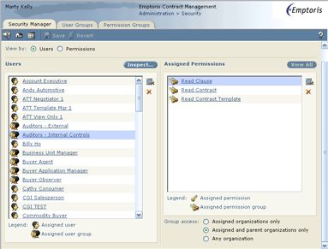
Contracts Security Options
Security and Organization Affiliation
The Organizational structure data set up in the system can be used to restrict access to instance-level objects
+
Object Level Permission
+
Group Assignment
=
Access limited to specific organizations
User Group

Slide 30
Restrict Security By Organization
Assigned & Parent Organizations Only
Assigned Organizations Only
Any Organization
User 1 and User 2 are both members of User Group A, but are in different organizations
User Group A is assigned “Contract > Read” Permission
Child Organization 2 is assigned to the contract template
The red ellipses show which Organizations are allowed access to the contract template with the different options

Slide 31
Clause & Contract Template Security
Clause & Contract Templates have 2 Security Lists
Template security list
Who can access the template object
Includes the ability to choose and view the (contract) template during contract creation.
Instance security list
Defines the initial security list for the clause or contract to be created from it
Includes the default permissions to be granted to the future creator of the clause or contract instance using this template

Slide 32
Configuring Contracts Security
Task 1: Create Organization Structure (VSM)
Task 2: Create Users (VSM)
Task 3: Create User Groups (VSM)
Task 4: Create Permission Groups
Task 5: Grant User Group Permissions
To repeat: As a best practice, granting permissions to Users at the class level is not recommended.
Even though a number of User Groups and Permission Groups are shipped with ECM and linked appropriately, it is normal to rework them during implementation, because the naming conventions and/or security details usually don’t exactly match the customer’s needs.

Slide 33
Security Notes
An aside: Emptoris Sourcing does security differently: it uses Roles, not Groups
Implementation:
During implementation it is convenient to add the implementation team members to the All Permissions user group. Since permissions are cumulative and there is no revoking of them, being a member of this group effectively gives all class-level and instance-level permissions. It is NOT RECOMMENDED to leave this setup in effect in production.
Customers often fail to test all user roles during Acceptance Test.
It’s also quite common for security changes to be requested after Acceptance Test
The moral of the story is to plan carefully and test thoroughly

Slide 34
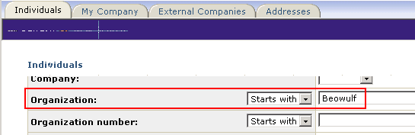
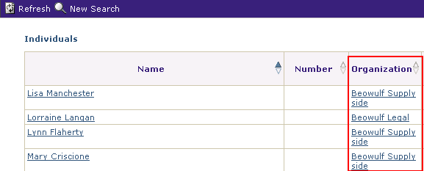
Security How To and Examples
(1) How do I find out which users are in a given Organization for ECM?
Recall that a user can be in a different Organization for each application.
The Organization on the General tab in the user profile in VSM has nothing to do with ECM, so searching on it is useless for ECM purposes. Instead, the user’s ECM Organization is the Organization in the Contract Management area on the Applications tab, but it can’t be searched on.
Solutions (both in ECM, under Administration):
Parties > Individuals. Do a search on the Organization name. [If you specify a name with spaces, it does not seem to work, so you may need to use a “Starts with” search on the first word of the name.]

Slide 35
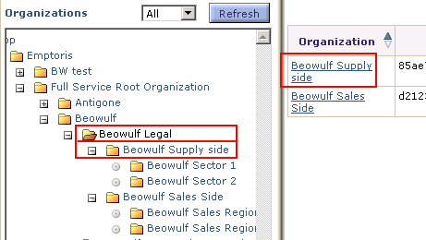
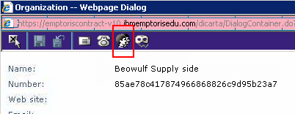
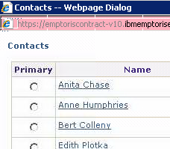
Security How To and Examples
(continued) How do I find out which users are in a given Organization for ECM?
Second solution (in ECM, under Administration):
( b) Parties > My Company. In the Organizations area on the left, navigate to and click on the parent of the organization of interest; its children will be listed on the right. Click on the organization of interest. In the Organization dialog, click on the Contacts icon. The contacts (both Users and Contacts) are listed.

Slide 36
Security How To and Examples
(2) Which contracts can a user see?
If the user performs a Detailed Search without specifying any search criteria, it will list all contracts having an Owning Organization equal to the user’s organization or (usually) a child of it.
Example: On the training system, log in as user Anne Humphries (login=ahum), who is in the Beowulf Supply Side organization, and try the above search. Record the contract numbers returned (e.g., 14, 15, 39).
Now do another Detailed Search, this time with a search on Owning Organization, using “Starts with” a letter that does NOT begin the user’s organization name
Example: Search using Owning Org Starts With “c” or “d” as user “ahum”.
There should be no contracts returned, because (in general) a user cannot see contracts outside his/her organization.

Slide 37
Security How To and Examples
(2) Which contracts can a user see? (continued)
For the next discussion, the pertinent part of our organization hierarchy is:
- Full Service Root Organization
- Beowulf
- Beowulf Legal
- Beowulf Supply Side (Anne Humphries; contracts 14, 15, 39)
- Beowulf Sector 1 (#40)
Log in as Beowulf_Inst (in the Full Service Root Organization) and perform a Detailed Search on Owning Organization, using “Starts with b” (for Beowulf and child organizations only).
Observe the contract numbers returned (e.g., 14, 15, 39, 40, and others). The list includes the contracts returned by Anne Humphries (previous slide), since her organization is under Beowulf_Inst’s in the hierarchy.
Notice that contract names were chosen to reflect the owning organization. Given the above organization hierarchy (especially Beowulf Sector 1 being under Beowulf Supply Side), you may wonder why contract 40, owned by Beowulf Sector 1, was listed in Beowulf_Inst’s search but not Anne’s. We will solve this mystery on the next slide.

Slide 38
Security How To and Examples
(2) Which contracts can a user see? (continued)
Solving the mystery from the previous slide ...
Look at contract 40 for clues (open it while logged in as Beowulf_Inst).
On the header tab, confirm the owning organization as Beowulf Sector 1
Go to Management > Security to look for clues related to security
We see that Supply Side Users (group) has Contract Read permission
(Digression: could confirm in SSM that Anne is in Supply Side Users)
So far, everything looks good.
Select the “Contract > Read” line in the Permissions pane and notice its “Group access” selection at the bottom: “Assigned organizations only”.
This is the problem! Since Anne is not in an organization of the contract, the Read permission does not apply. If we were to change to “Assigned and parent organizations only”, it would work.
Q: But why can Beowulf_Inst see contract 40? A: That user is not in the Supply Side Users, so the group/organization restriction does not apply.

Slide 39
Questions?

